Slide 1


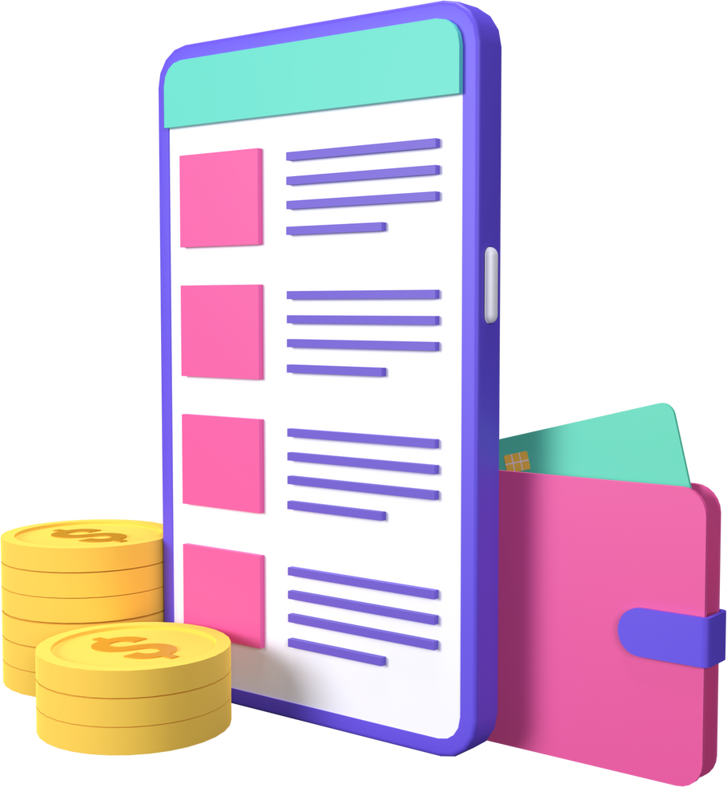


SIH:25132
Home
About us
Service
Contact
FinTastic
GenAI for Financial Empowerment
Student Innovation: Swadeshi for Atmanirbhar Bharat - Miscellaneous
Technology ideas in tertiary sectors like Hospitality, Financial Services, Entertainment and Retail.
Team Members: Calvin, Erum, Hitesh, HIthansh, Narayanan, Sujal
Next

Slide 2




SIH:25132
Home
About us
Service
Contact
Our Solution: FinTera
FinTera is a Generative AI-powered personal financial coach designed as an inclusive, one-stop solution to simplify financial planning for underserved communities.
Key Features & Functionalities:
Learn Tab: Educational content, guides, and tutorials to improve financial literacy.
Services / Tools: Credit cards, loans, investments, SIPs, tax calculators — interactive, visual, and easy to compare.
Stocks Advisor: Mini dashboards, trending stocks, and portfolio insights for smarter investing.
Multi-language (10+ Indian languages) with built-in TTS for inclusive, accessible learning and mass adoption.
AI Assistant: Chatbot to guide users, provide personalized suggestions, and simplify decisions in multiple languages.
Previous
Next

Slide 3

SIH:25132
Home
About us
Service
Contact
FEASIBILITY & VIABILITY
Existing tools are fragmented and complex. Users juggle multiple apps for payments, investments, and analytics. Our product puts everything in one simple platform.
Advantages:
All-in-one: Banking, investments, and analytics.
Time-saving: No app-switching.
Secure: Encrypted, reliable APIs.
Scalable: Easy to add new tools.
Risks & Mitigation:
API downtime → use backups & caching.
Data security → encryption & secure backend.
Adoption → intuitive UX, clear value.
Previous
Next
By simplifying finance in one platform, we turn complexity into clarity and convenience, making the product feasible and highly viable.

Slide 4

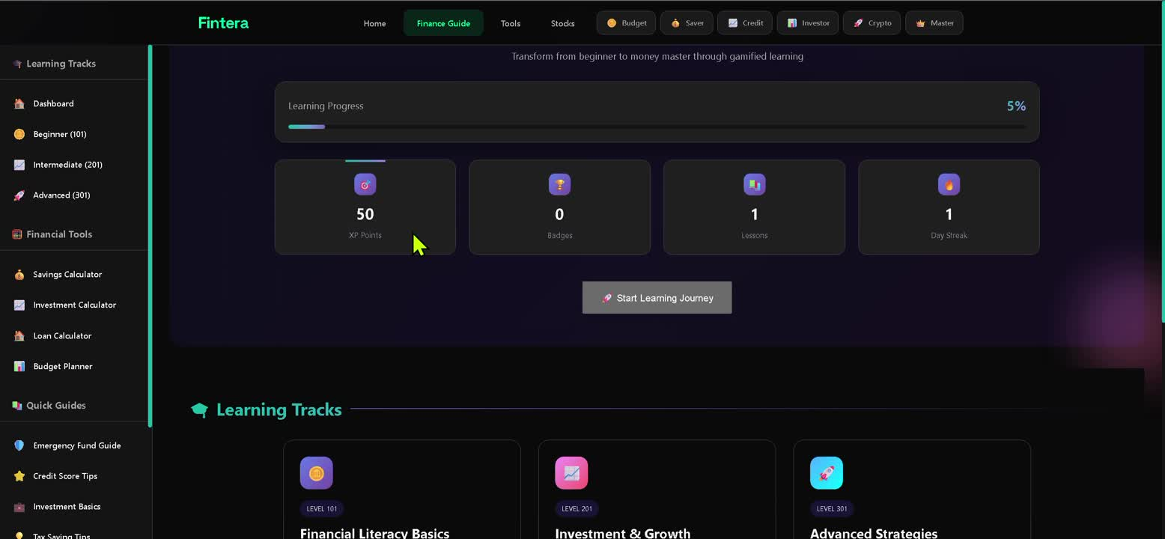
SIH:25132
Home
About us
Service
Contact
Technical Approach
1
Programming Languages:
Python – Backend logic, API integration, data processing
JavaScript – Frontend interactivity, dynamic UI updates
2
Frameworks and Libraries:
PostgreSQL: A powerful, reliable database for handling financial data with speed, security, and scalability.
React.js – For a more dynamic, interactive frontend experience.
Tailwind CSS – Sleek, responsive, and minimal UI components
Django: A secure, scalable backend framework to handle user flows, APIs, and data management with speed and reliability.
FastAPI:In our website, FastAPI will serve as the backend to handle user requests, integrate external APIs, and deliver real-time data efficiently.
3
APIs (Fintech Integration):
Setu API – Open banking, UPI payments, account aggregation
Razorpay API – Payment gateway, subscription billing
Zerodha Kite Connect API – Stock market data and trading functionalities
Plaid API – Secure bank account linking and data aggregation
i18n API: Breaks language barriers with 10+ Indian languages, making finance truly for everyone.
Google Translate API: Instantly enables multi-language support with accurate, scalable translations for diverse Indian users.
Yahoo Finance API / Google Finance API :Provide real-time and historical stock market data, financial news, and analytics for informed decision-making.
Previous
Next

Slide 5

SIH:25132
Home
About us
Service
Contact
QUANTITATIVE BEnefits
QUALITative Benefits:
IMPACT AND BENEFITS
Financial Inclusion: Reaching underserved communities often ignored by traditional fintech.
Social Impact: Contributing to national goals of Digital India and financial inclusion.
Future Scope:
Investment Nudges: Offering micro-investment suggestions based on user behavior.
Credit Score Guidance: Providing personalized advice to improve credit health.
Regional Language Expansion: Adding more Indian languages for wider reach.
Behavioral Change: Encouraging consistent savings and positive financial habits through gamification.
Empowerment: Giving individuals the tools to manage their finances with confidence.
Increased Literacy: Simplifying complex topics to make financial education truly accessible.
Innovation: Creating a unique, voice-first solution that stands out in the market.
Previous
Next

Slide 6


SIH:25132
Home
About us
Service
Contact
Future Goals & Scalability
Gamification & Engagement:
Quizzes, streaks, badges, and rewards to boost learning and usage.
Community features: leaderboards, challenges, and user tips.
Platform Expansion:
Mobile apps (React Native) for iOS & Android.
Regional language support (10+ Indian languages) for mass adoption.
WhatsApp / Telegram bots for micro-learning & finance alerts.
Monetization & Premium Features:
Paid tiers or token-based models for advanced tools.
Newsletter subscriptions with personalized insights.
Integration of advanced AI/ML for recommendations, portfolio insights, and
personalized guidance.
Vision:
Evolve Fintera into India’s go-to all-in-one financial companion, growing with users’ financial knowledge and needs.
Previous
Next

